Slide 1
The evolution of wheat: a chloroplast genome story
Ann Murithi
Final Project: EEOB 563 – Molecular phylogenetics
3rd May 2021

Slide 2
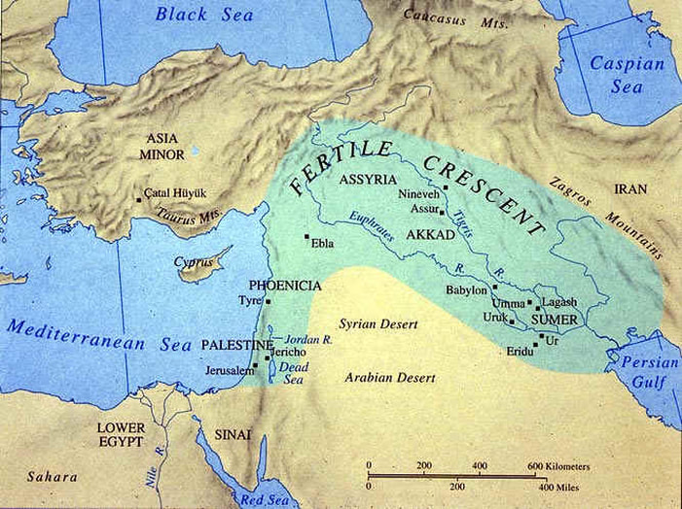
The origin of wheat
First cultivation of wheat (diploid and tetraploid) occurred about 10000 years ago, as part of the ‘Neolithic Revolution’
Cultivation spread to the Near East
9000 years ago hexaploid bread wheat made its first appearance
The main route into Europe via
Greece (8000 BP)
Balkans to the Danube (7000 BP)
Italy, France and Spain (7000 BP),
UK and Scandinavia by about 5000 BP
The fertile crescent
Notes:
The Fertile Crescent is a crescent-shaped region in the Middle East, spanning modern-day Iraq, Syria, Lebanon, Palestine, Israel, Jordan, and Egypt, together with the southeastern region of Turkey and the western fringes of Iran

Slide 3
Wheat evolution: Main events
T.Urartu
(AA)
Diploid (BB)
Diploid (GG)
T. timopheevii
(AAGG)
T.turgidum
(AA)
T. monococcum AA
T. tauchii DD
T.timopheevii
(AAAAGG)
T.aestivum
(AABBDD)
Timopheevii lineage
Emmer lineage

Slide 4


Why is this important
The ability of chromosome doubling in wheat creates a great avenue for wheat improvement
Allows for crossing of wheat with wild diploid species.
Introduces genetic variety and novel alleles for important traits. E.g., Drought tolerance, disease resistance, heat shock tolerance…

Slide 5
Chloroplast genome and evolution
Characteristics
Highly conserved, both in gene order and gene content
Low rate of evolution
Maternally inherited
Good models for testing lineage-specific molecular evolution
LSC
Gene composition and organization in angiosperms
Large single copy (LSC) regions
Small single copy (SSC)
Inverted repeats
The genome encodes approximately 115-116 genes
IRb
Sources of variations
Structural rearrangements
Gene loss
IR expansion
Inversion
IRa
SSC
Indels, small inversions, and inverted repeats have provided valuable resources to study molecular evolution in plants

Slide 6
Materials
Ploidy level | Genus | Species | Number | Lineage
Diploid | Aegilops | speltoids | 3
 |  | searsii | 3
 |  | sharonensis | 2
 |  | longissima | 1
 |  | kotschyi | 1
 |  | tauchii | 1
 |  | birconis | 1
 | Triticum | urartu | 1
Tetraploid | Triticum turgidum | ssp. durum | 1 | Emmer
 |  | ssp. carthlicum | 2
 |  | ssp. dicoccoides | 3
 | Triticum timophevii | ssp. armeniacum | 3 | Timpheevii
Hexaploid | Triticum | aestivum | 2

Slide 7
Phylogenetic analysis
Sequence Alignment using MAFFT
Build phylogenetic trees
GenBank
Whole chloroplast genome
Construction phylogenetic tree based on MEGA - X
NJ based on JC distances
ML tree – 1000 bootstrap

Slide 8
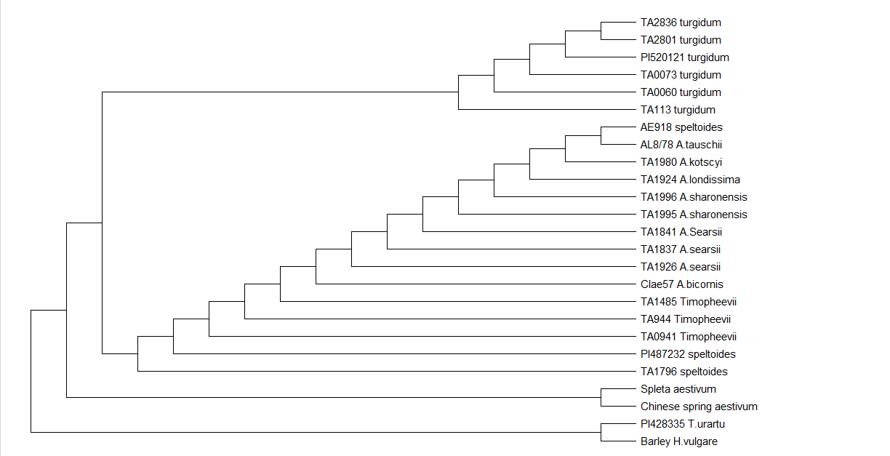
Maximum parsimony – MEGA-X

Slide 9
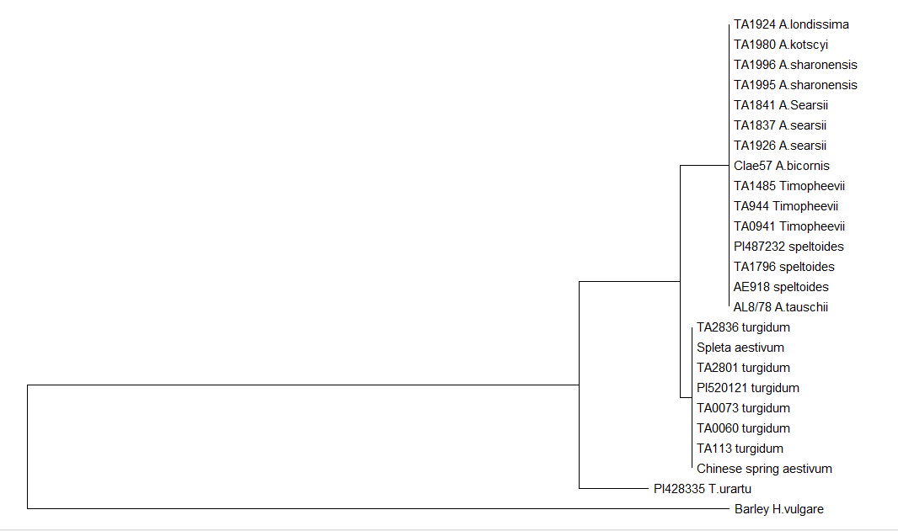
Maximum Likelihood – MEGA-X

Slide 10
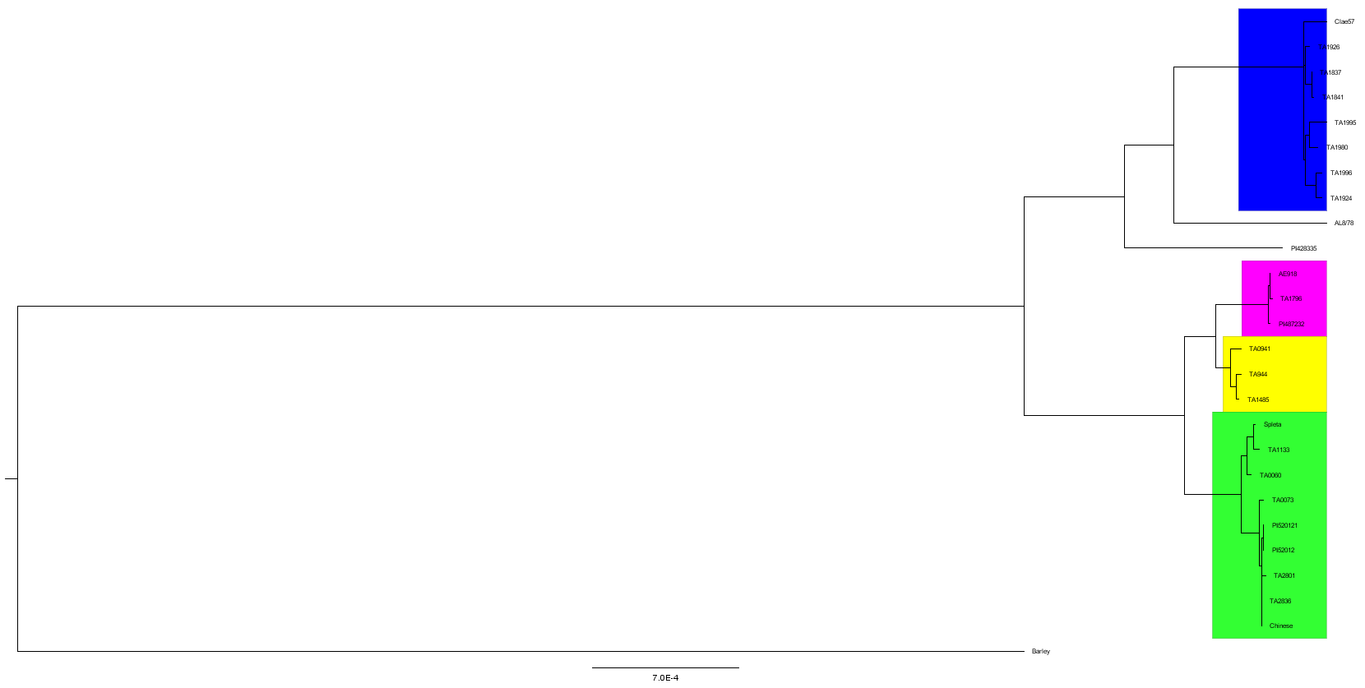
Neighbor Joining
Blue – Diploids (All Ageilops)
Pink – Diploid (Speltoids)
Yellow – Timophevevii
Green – T. aestivum + T. turgidum

Slide 11
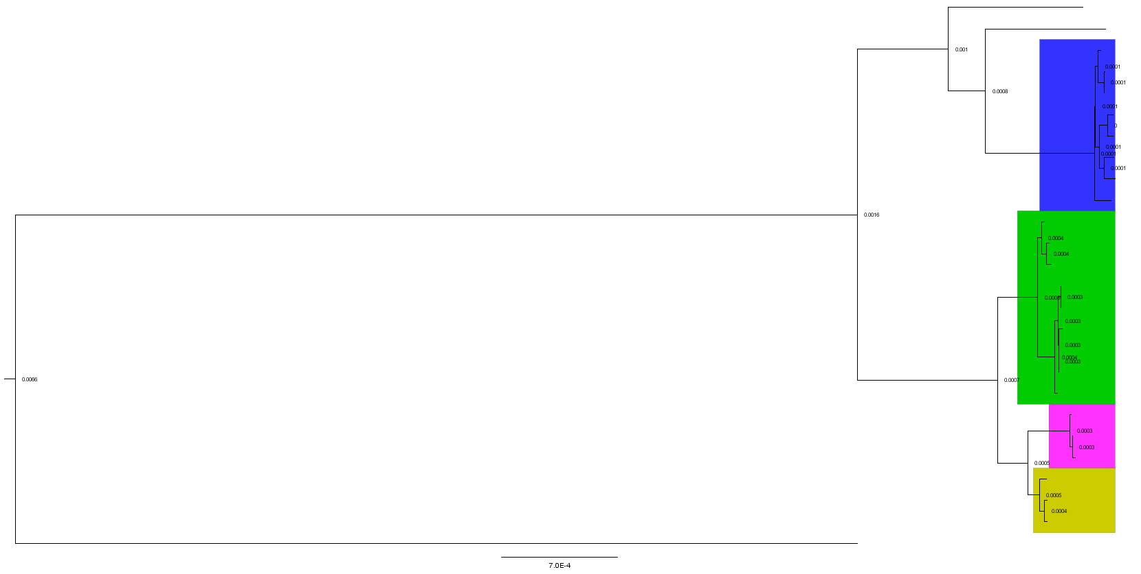
Maximum Likelihood
Blue – Diploids (All Ageilops)
Pink – Diploid (Speltoids)
Yellow – Timophevevii
Green – T. aestivum + T. turgidum

Slide 12
Conclusion
The topology of NJ and ML phylogenetic trees was the same. Possibly indicates the strong relations among the individuals in the taxa
The ML tree produce for MEGA-X program was different. Possibly could not detect the small variation within the taxa, especially those of similar ploidy levels
The source of maternal genome (BB) remains elusive. Possibly is extinct or yet to be discovered
The source of maternal genome in (GG) the Timopheevii lineage is A. spletoids

Slide 13

Thank you
Dr. Dennis Lavrov
Classmates

